Slide 1
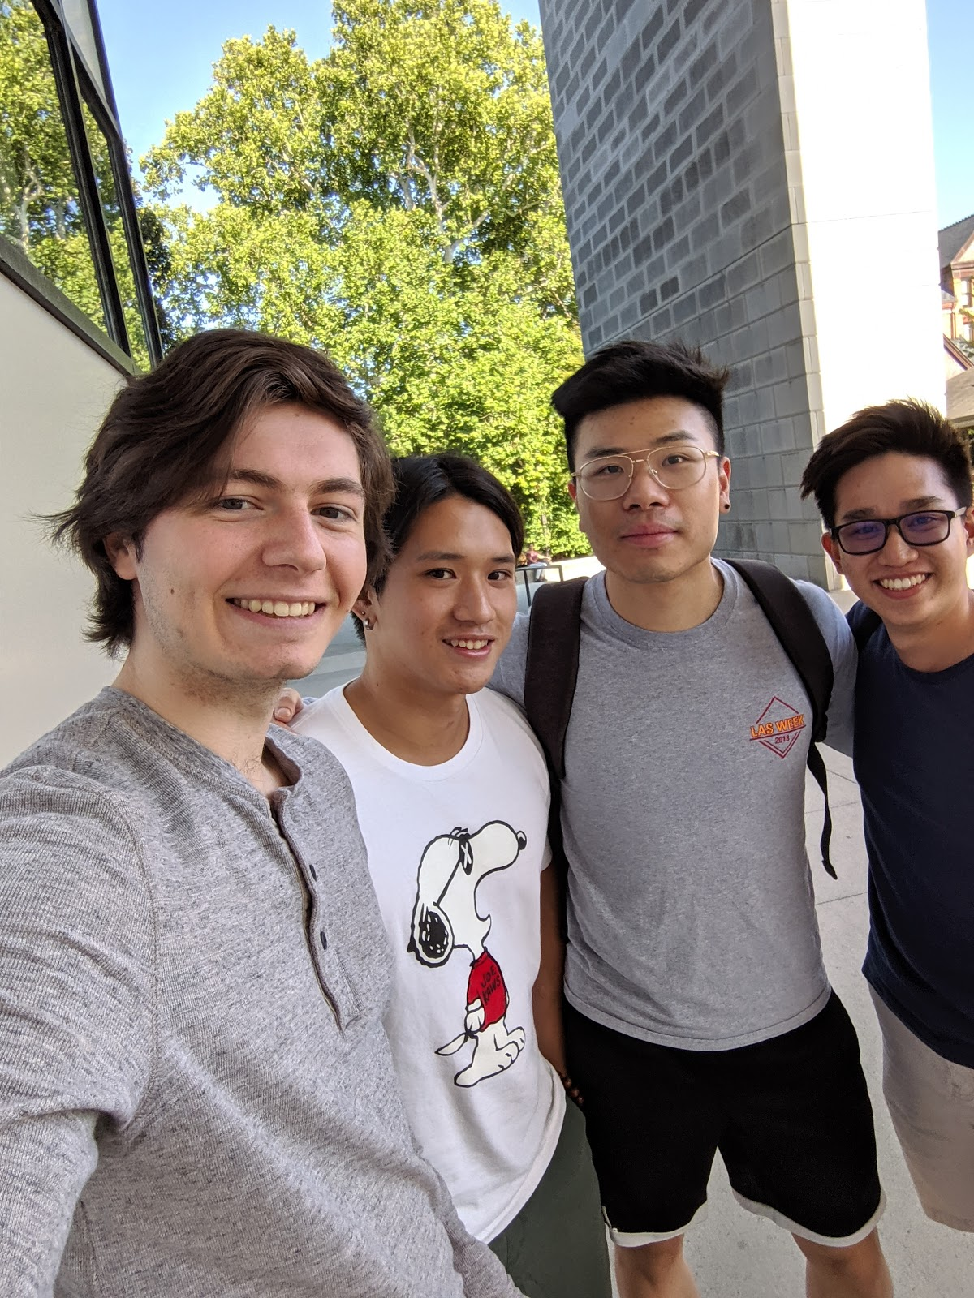
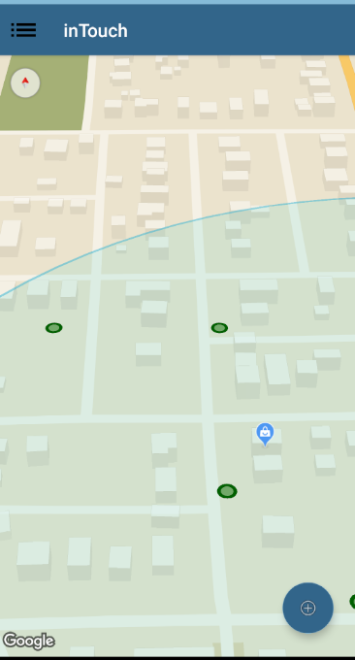
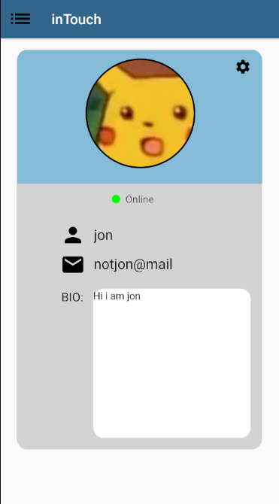
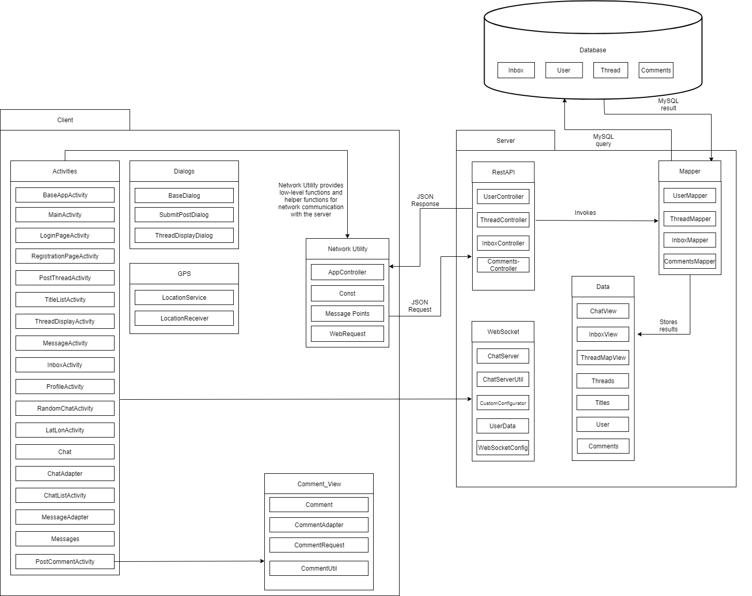
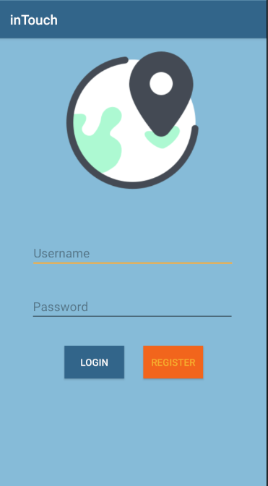
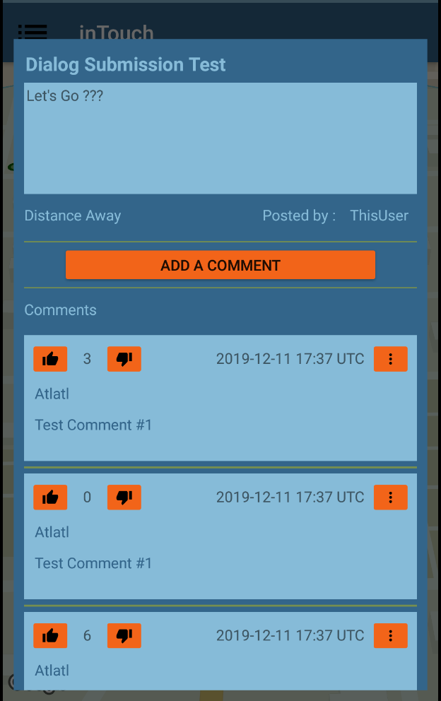
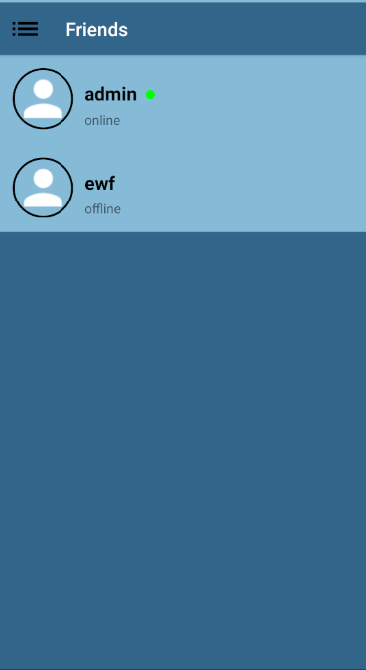
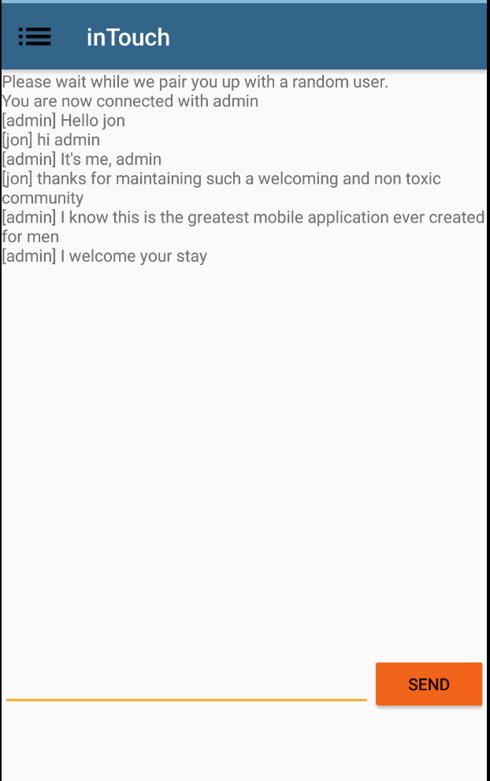
InTouch App
Aaron Thune
Guang Yi Lim
Xin Jun Loh
Yew Ken Chai
COM S 309 2019
Project Description:
An Application which brings people closer. Connect with people around you and feel more intouch.
Post messages which can be seen by people near you
Comment on or rate nearby posts
Get connected with people around and start chatting
Users:
Public Users
Administrators
User Interfaces
Inbox view
User can see a list of latest conversations they are having with their friend.
Interactive Map
User can see where their location on the map and surrounding messages
Message view
Look at other people’s messages and comment on them
Random Chat
Get paired up with a stranger and chat with them
Module Interfaces:
Network interface
Server requests for post retrieval
Web socket connection for user-to-user private chat
Location Service/Receiver System
Background service for real-time location updates
Base class for app activities receiving location updates
Design Decisions:
Creating a base class for all app activities to handle common app operations
Navigation between activities
Real-time location updates
Revolve app usage around the map activity
Interactable map objects for nearby threads
Threads and Post/Comment submission appear as dialogs over the map
Team Info:
Team YT_3
Aaron Thune – CPRE (Sr)
Guang Yi Lim – COM S (Sr)
Xin Jun Loh – COM S (Jr)
Yew Ken Chai – COM S (Jr)
What went wrong:
Still missing some proposed features
Aesthetic of the applications is not what we expected
Image uploading
What went right:
All use cases are working
Application does not crash
Image downloading
Lessons Learned:
Learned how to code in Android Studio
Learned how to use websockets, Android volley, spring boot, MVC, CICD, Git, Maven, and Mockito.

Slide 2
